Slide 1
Unit-1

Slide 2
THE NEED FOR SECURITY
Most previous computer applications had no, or at best, very little security. This continued for a number of years until the importance of data was truly realized. Until then, computer data was considered to be useful, but not something to be protected.
When computer applications were developed to handle financial and personal data, the real need for security was felt like never before. People realized that data on computers is an extremely important aspect of modern life. Therefore, various areas in security began to gain prominence. Two typical examples of such security mechanisms were as follows

Slide 3
Provide a user identification and password to every user, and use that information to authenticate a user.
Encode information stored in the databases in some fashion, so that it is not visible to users who do not have the right permission
There were many examples of what could happen if there was insufficient security built in applications developed for the Internet. Figure 1.1 shows such an example of what can happen when you use your credit card for making purchases over the Internet. From the user’s computer, the user details such as user id, order details such as order id and item id,

Slide 4
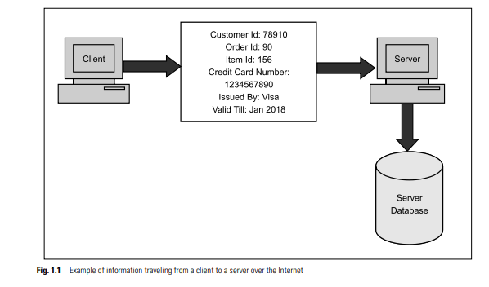
Figure 1.1 shows such an example of what can happen when you use your credit card for making purchases over the Internet. From the user’s computer, the user details such as user id, order details such as order id and item id, and payment details such as credit-card information travel across the Internet to the server (i.e. to the merchant’s computer). The merchant’s server stores these details in its database.

Slide 5
Modern Nature of Attacks
If we attempt to demystify technology, we would realize that computer-based systems are not all that different from what happens in the real world.
We can highlight a few salient features of the modern nature of attacks, as follows:
1. Automating Attacks: The speed of computers make several attacks worthwhile for miscreants. For example, in the real world, let’s suppose someone manages to create a machine that can produce counterfeit coins.

Slide 6
2. Privacy Concern
Collecting information about people and later (mis)using it is turning out to be a huge problem these days. The so-called data mining applications gather, process, and tabulate all sorts of details about individuals. People can then illegally sell this information.
3.Distance Does not Matter Thieves would earlier attack banks, because banks had money. Banks do not have money today! Money is in digital form inside computers, and moves around by using computer networks.

Slide 7
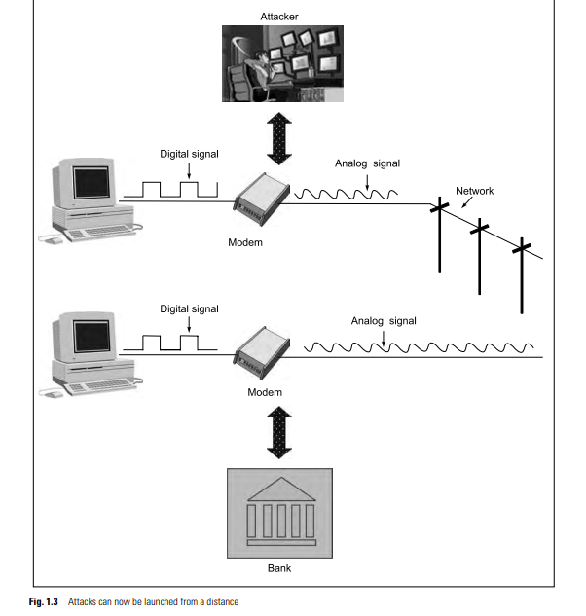

Slide 8
Security approaches
i. Authentication: The assurance that the communicating entity is the one that it claims to be.
ii.Access control: The prevention of unauthorized use of a resource
iii.Data confidentiality: The protection of data from unauthorized
disclosure.
iii.Data integrity: The assurance that data received are exactly as
sent by an authorized entity
iv.Non –repudiation: Provides protection against denial by one of the entities involved in a communication of having participated in all or part of the communication.

Slide 9
Principles of security
This definition introduces three key objectives that are at the heart of
computer security:
1.Confidentiality: This term covers two related concepts:
Data confidentiality: Assures that private or confidential information is not made available or disclosed to unauthorized individuals.
Privacy: Assures that individuals control or influence what information related to them may be collected and stored and by whom and to whom that information may be disclosed.

Slide 10
2.Integrity: This term covers two related concepts:
Data integrity: Assures that information and programs are changed only in a specified and authorized manner.
System integrity: Assures that a system performs its intended function in an unimpaired manner, free from deliberate or inadvertent unauthorized
manipulation of the system.
3.availability: Assures that systems work promptly and service is not denied to authorized users.

Slide 11
The Open Systems Interconnection (OSI) security architecture provides a systematic framework for defining security attacks, mechanisms, and services.
◆ Security attacks are classified as either passive attacks, which include unauthorized reading of a message of file and traffic analysis or active attacks, such as modification of messages or files, and denial of service.
◆ A security mechanism is any process (or a device incorporating such aprocess) that is designed to detect, prevent, or recover from a security attack. Examples of mechanisms are encryption algorithms, digital signatures, and
authentication protocols.
◆ Security services include authentication, access control, data confidentiality, data integrity, nonrepudiation, and availability

Slide 12
Security attacks
Passive Attacks
Passive attacks are in the nature of eavesdropping on, or monitoring of, transmis-sions
the release of message contents is easily understood (Figure 1.2a).A telephone conversation, an electronic mail message, and a transferred file may contain sensitive or confidential information
second type of passive attack, traffic analysis, is subtler (Figure 1.2b). Suppose that we had a way of masking the contents of messages or other information traffic so that opponents, even if they captured the message,

Slide 13
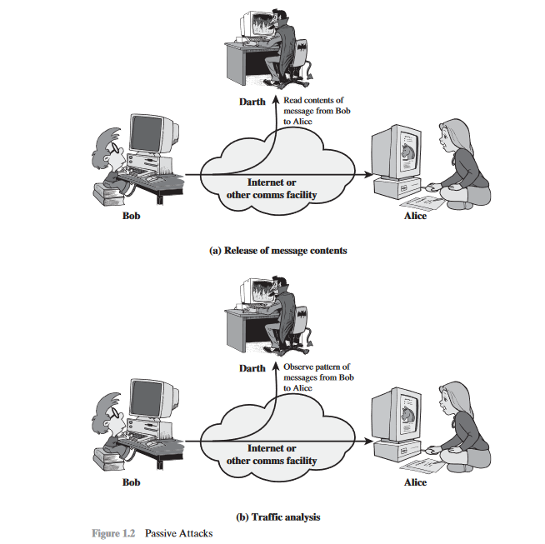

Slide 14
ii.Active attacks :involve some modification of the data stream or the creation of a false stream and can be subdivided into four categories: masquerade, replay, modification of messages, and denial of service
A masquerade takes place when one entity pretends to be a different entity (Figure 1.3a). A masquerade attack usually includes one of the other forms of active attack.
Replay involves the passive capture of a data unit and its subsequent retrans- mission to produce an unauthorized effect (Figure 1.3b).
Modification of messages simply means that some portion of a legitimate message is altered, or that messages are delayed or reordered, to produce an unau-thorized effect.
The denial of service prevents or inhibits the normal use or management of communications facilities

Slide 15
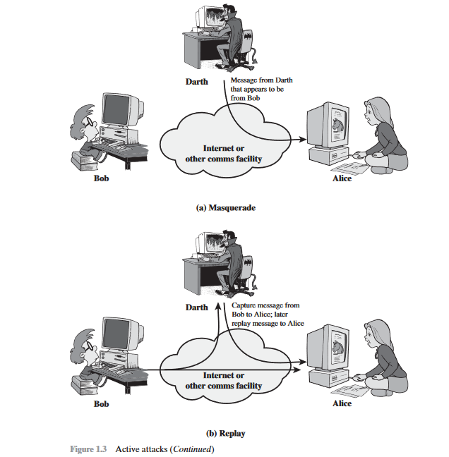

Slide 16
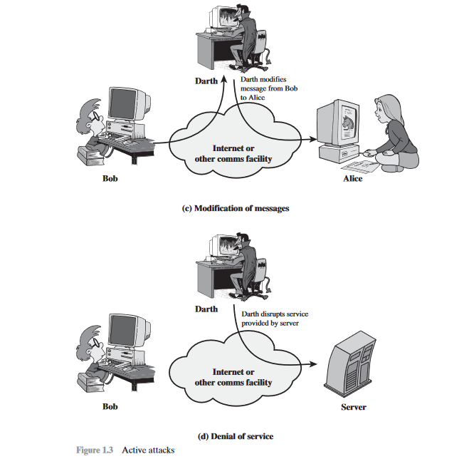

Slide 17
Security Services
AUTHENTICATION
The assurance that the communicating entity is the one that it claims to be.
i.Peer Entity Authentication
Used in association with a logical connection to provide confidence in the identity of the entities connected.
iiData-Origin Authentication
In a connectionless transfer, provides assurance that the source of received data is as claimed.
ACCESS CONTROL
The prevention of unauthorized use of a resource (i.e., this service controls who can have access to a resource, under what conditions access can occur, and what those accessing the resource are allowed to do).

Slide 18
DATA CONFIDENTIALITY
The protection of data from unauthorized disclosure.
Connection Confidentiality
The protection of all user data on a connection.
Connectionless Confidentiality
The protection of all user data in a single data block
Selective-Field Confidentiality
The confidentiality of selected fields within the user data on a connection or in a single data block.
Traffic-Flow Confidentiality
The protection of the information that might be derived from observation of traffic flows.

Slide 19
DATA INTEGRITY
The assurance that data received are exactly as sent by an authorized entity (i.e., contain no modification, insertion, deletion, or replay).
Connection Integrity with Recovery Provides for the integrity of all user data on a connection and detects any modification, insertion, deletion, or replay of any data within an entire data sequence, with recovery attempted.
Connection Integrity without Recovery :As above, but provides only detection without recovery.
Selective-Field Connection Integrity
Provides for the integrity of selected fields within the user data of a data block transferred over a connections
Connectionless Integrity: Provides for the integrity of a single connectionless data block and may take the form of detection of data modification.
Selective-Field Connectionless Integrity
Provides for the integrity of selected fields within a single connectionless data block; takes the form of determination of whether the selected fields have been modified.

Slide 20
NONREPUDIATION
Provides protection against denial by one of the entities involved in a communication of having participated in all or part of the communication.
Nonrepudiation, Origin
Proof that the message was sent by the specified party.
Nonrepudiation, Destination
Proof that the message was received by the specified
party.

Slide 21
Security Mechanisms
i.SPECIFIC SECURITY MECHANISMS
May be incorporated into the appropriate protocol layer in order to provide some of the OSI security services.
Encipherment
The use of mathematical algorithms to transform data into a form that is not readily intelligible. The transformation and subsequent recovery of the data depend on an algorithm and zero or more encryption keys.
Digital Signature
Data appended to, or a cryptographic transformation of, a data unit that allows a recipient of the data unit to prove the source and integrity of the data unit and protect against forgery (e.g., by the recipient).

Slide 22
Access Control
A variety of mechanisms that enforce access rights to resources.
Data Integrity
A variety of mechanisms used to assure the integrity of a data unit or stream of data units.
Authentication Exchange
A mechanism intended to ensure the identity of an entity by means of information exchange.
Traffic Padding
The insertion of bits into gaps in a data stream to frustrate traffic analysis attempts.
Routing Control
Enables selection of particular physically secure routes for certain data and allows routing changes, especially when a breach of security is suspected.
Notarization
The use of a trusted third party to assure certain properties of a data exchange

Slide 23
ii.PERVASIVE SECURITY MECHANISMS
Mechanisms that are not specific to any particular OSI security service or protocol layer.
Trusted Functionality
That which is perceived to be correct with respect to some criteria (e.g., as established by a security policy).
Security Label
The marking bound to a resource (which may be a data unit) that names or designates the security attributes of that resource.
Event Detection
Detection of security-relevant events.
Security Audit Trail
Data collected and potentially used to facilitate a security audit, which is an independent review and examination of system records and activities.
Security Recovery
Deals with requests from mechanisms, such as event handling and management functions, and takes recovery action

Slide 24
A model for network security
A message is to be transferred from one party to another across some sort of Internet service. The two parties, who are the principals in this transaction, must cooperate for the exchange to take place. A logical information channel is established by defining a route through the Internet from source to destination and by the cooperative use of communication protocols (e.g., TCP/IP) by the two principals.

Slide 25
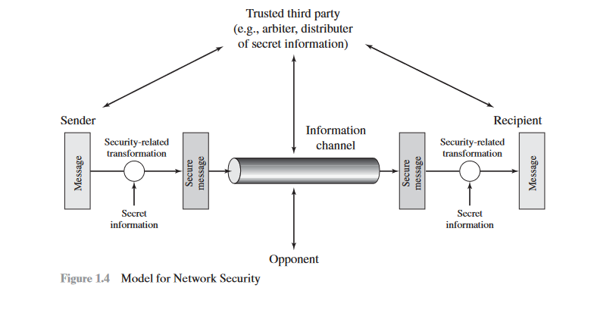

Slide 26
This general model shows that there are four basic tasks in designing a particular security service:
1. Design an algorithm for performing the security-related transformation. The algorithm should be such that an opponent cannot defeat its purpose.
2. Generate the secret information to be used with the algorithm.
3. Develop methods for the distribution and sharing of the secret information.
4. Specify a protocol to be used by the two principals that makes use of the security algorithm and the secret information to achieve a particular security service.

Slide 27
Symmetric cryptography
Symmetric encryption is a form of cryptosystem in which encryption and decryption are performed using the same key. It is also known as conven-tional encryption.
◆ Symmetric encryption transforms plaintext into ciphertext using a secret key and an encryption algorithm. Using the same key and a decryption algorithm, the plaintext is recovered from the ciphertext.
◆ The two types of attack on an encryption algorithm are cryptanalysis, based on properties of the encryption algorithm, and brute-force, which involves trying all possible keys.

Slide 28
A symmetric encryption scheme has five ingredients
Plaintext: This is the original intelligible message or data that is fed into the algorithm as input.
Encryption algorithm: The encryption algorithm performs various substitutions and transformations on the plaintext.
•Secret key: The secret key is also input to the encryption algorithm. The key is a value independent of the plaintext and of the algorithm.

Slide 29
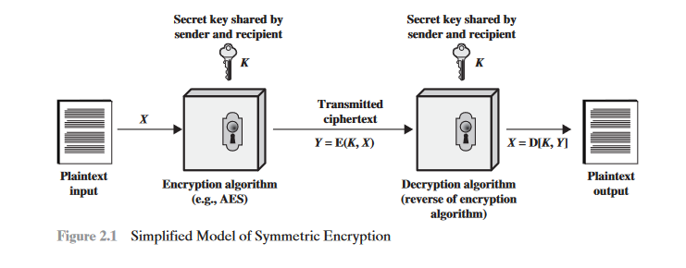
Ciphertext:This is the scrambled message produced as output. It depends on the plaintext and the secret key. For a given message, two different keys will produce two different ciphertexts.
Decryption algorithm: This is essentially the encryption algorithm run in reverse. It takes the ciphertext and the secret key and produces the original plaintext.

Slide 30
asymmetric cryptography
Asymmetric encryption is a form of cryptosystem in which encryption and decryption are performed using the different keys—one a public key and one a private key. It is also known as public-key encryption.
◆ Asymmetric encryption transforms plaintext into ciphertext using a one of two keys and an encryption algorithm. Using the paired key and a decryp- tion algorithm, the plaintext is recovered from the ciphertext.
◆ Asymmetric encryption can be used for confidentiality, authentication,
or both.
The most widely used public-key cryptosystem is RSA. The difficulty of
attacking RSA is based on the difficulty of finding the prime factors of a com-
posite number.

Slide 31
asymmetric cryptography
A public-key encryption scheme has six ingredients
plaintext: This is the readable message or data that is fed into the algorithm as input.
Encryption algorithm: The encryption algorithm performs various transformations on the plaintext.
Public and private keys: This is a pair of keys that have been selected so that if one is used for encryption, the other is used for decryption.

Slide 32
Ciphertext: This is the scrambled message produced as output. It depends on the plaintext and the key. For a given message, two different keys will produce two different ciphertexts.
•Decryption algorithm: This algorithm accepts the ciphertext and the matching key and produces the original plaintext.

Slide 33
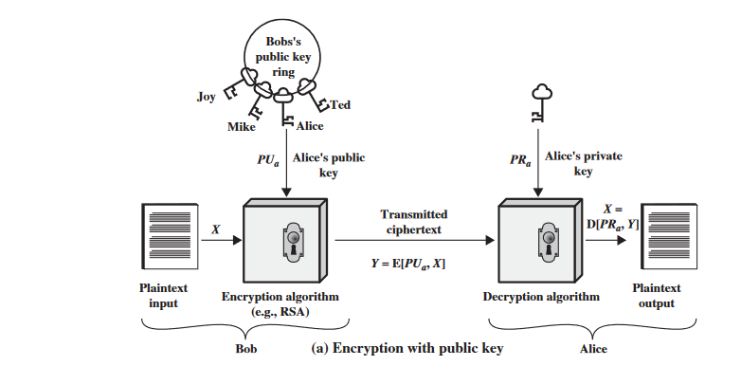

Slide 34
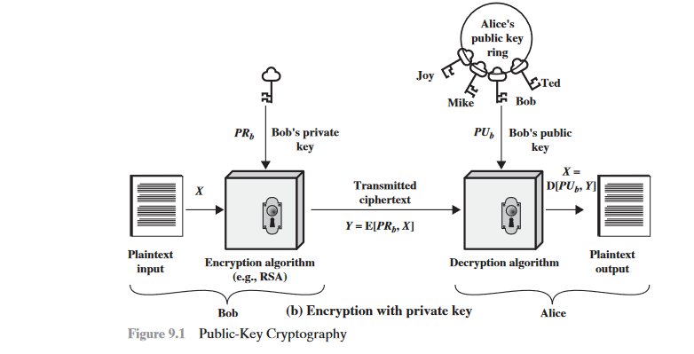

Slide 35
1.Each user generates a pair of keys to be used for the encryption and decryp-tion of messages.
2. Each user places one of the two keys in a public register or other accessible file.
3. If Bob wishes to send a confidential message to Alice, Bob encrypts the message using Alice’s public key.
4. When Alice receives the message, she decrypts it using her private key. No other recipient can decrypt the message because only Alice knows Alice’s private key

Slide 36
SUBSTITUTION TECHNIQUES
The Caesar cipher is a special case of substitution technique wherein each alphabet in a message is replaced by an alphabet three places down the line. For instance, using the Caesar cipher, the plain-text ATUL will become cipher-text DWXO.
In the substitution-cipher technique, the characters of a plain-text message are replaced by other characters, numbers or symbols.
Clearly, the Caesar cipher is a very weak scheme of hiding plain-text messages. All that is required to break the Caesar cipher is to do the reverse of the Caesar cipher process—i.e. replace each alphabet in a cipher-text message produced by Caesar cipher with the alphabet that is three places up the line. Thus, to work backwards, take a cipher text produced by Caesar cipher, and replace each A with X, B with Y, C with Z, D with A, E with B and so on. T

Slide 37
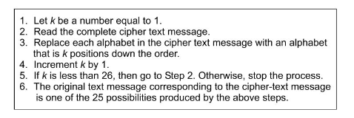
Modified Version of Caesar Cipher

Slide 38
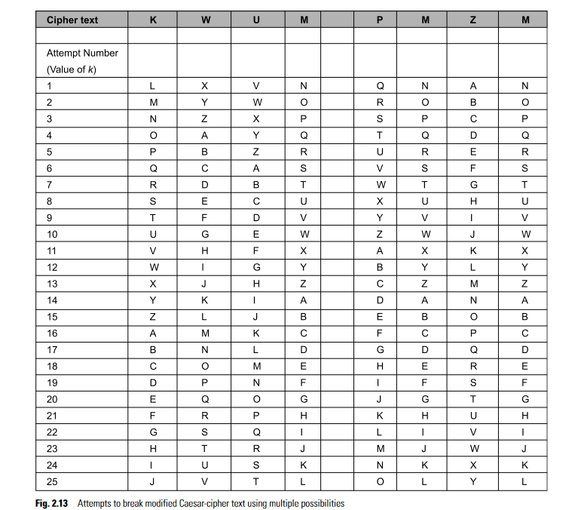

Slide 39
Mono-alphabetic Cipher
The major weakness of the Caesar cipher is its predictability. Once we decide to replace an alphabet in a plain-text message with an alphabet that is k positions up or down the order, we replace all other alphabets in the plain-text message with the same technique. Thus, the cryptanalyst has to try out a maximum of 25 possible attacks, and he/she is assured of success.
Mono-alphabetic ciphers pose a difficult problem for a cryptanalyst because it can be very dif- ficult to crack, thanks to the high number of possible permutations and combinations.

Slide 40
To put it mathematically, we can now have any permutation or combination of the 26 alphabets, which means (26 *25 * 24 * 23 * … 2) or 4 * 10 power 26 possibilities! This is extremely hard to crack. It might
actually take years to try out these many combinations even with the most modern computers.

Slide 41
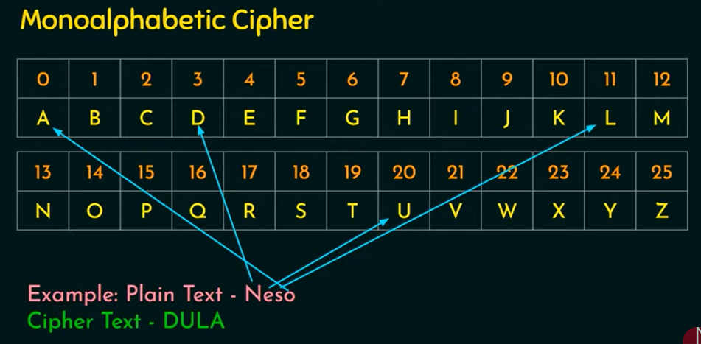

Slide 42
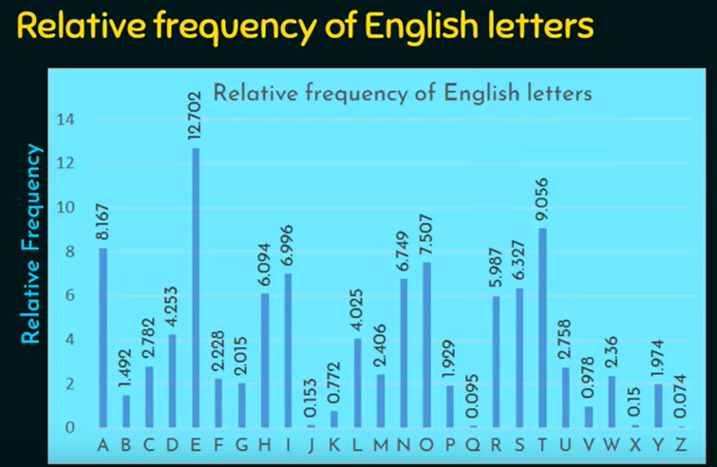

Slide 43
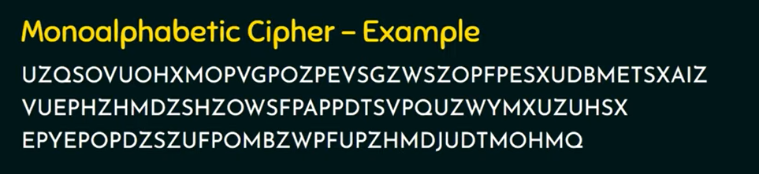

Slide 44
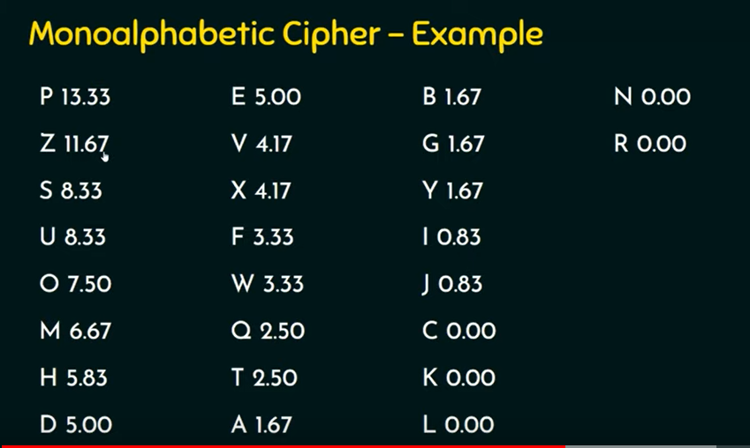

Slide 45
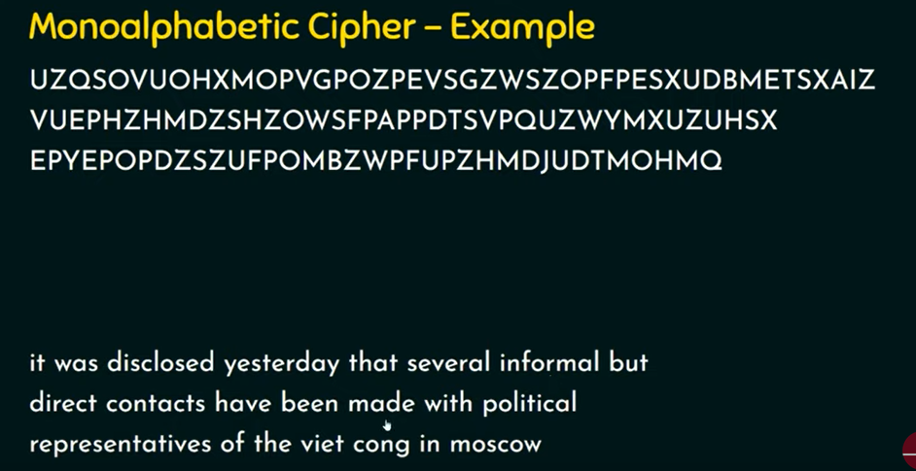

Slide 46
Homophonic Substitution Cipher
The homophonic substitution cipher is very similar to mono-alphabetic cipher. Like a plain substitution cipher technique, we replace one alphabet with another in this scheme. However, the difference between the two techniques is that whereas the replacement alphabet set in case of the simple substitution techniques is fixed (e.g. replace A with D, B with E, etc.), in the case of homophonic substitution cipher, one plain-text alphabet can map to more than one cipher-text alphabet. For instance, A can be replaced by D, H, P, R; B can be replaced by E, I, Q, S, etc.Homophonic substitution cipher also involves substitution of one plain-text character with a cipher-text character at a time, however the cipher-text character can be any one of the chosen set

Slide 47
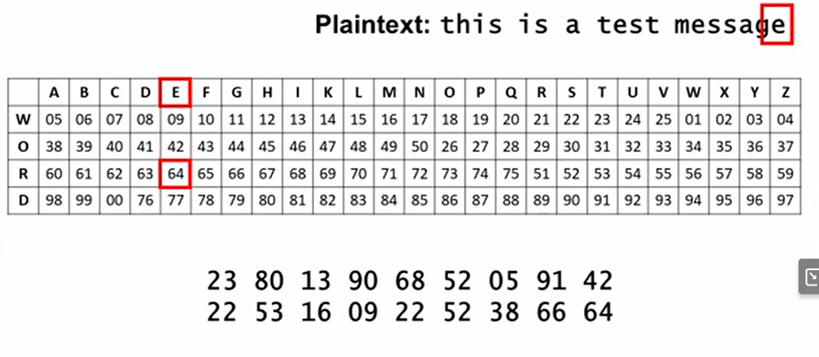

Slide 48
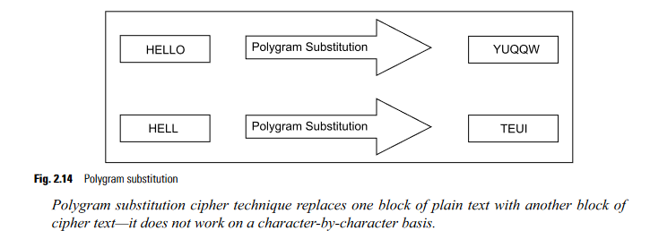
Polygram Substitution Cipher
In the polygram substitution cipher technique, rather than replacing one plain-text alphabet with one cipher text alphabet at a time, a block of alphabets is replaced with another block. For instance, HELLO could be replaced by YUQQW, but HELL could be replaced by a totally different cipher text block TEUI, as shown in Fig

Slide 49
Polyalphabetic Substitution Cipher
The Vigenére cipher and the Beaufort cipher are examples of polyalphabetic substitution cipher. This cipher uses multiple one-character keys. Each of the keys encrypts one plain-text character. The first key encrypts the first plain-text character; the second key encrypts the second plain-text character, and so on. After all the keys are used, they are recycled. Thus, if we have 30 one-letter keys, every 30th character in the plain text would be replaced with the same key. This number (in this case, 30) is called the period of the cipher.
The main features of polyalphabetic substitution cipher are the following:
(a) It uses a set of related mono alphabetic substitution rules.
(b) It uses a key that determines which rule is used for which transformation

Slide 50
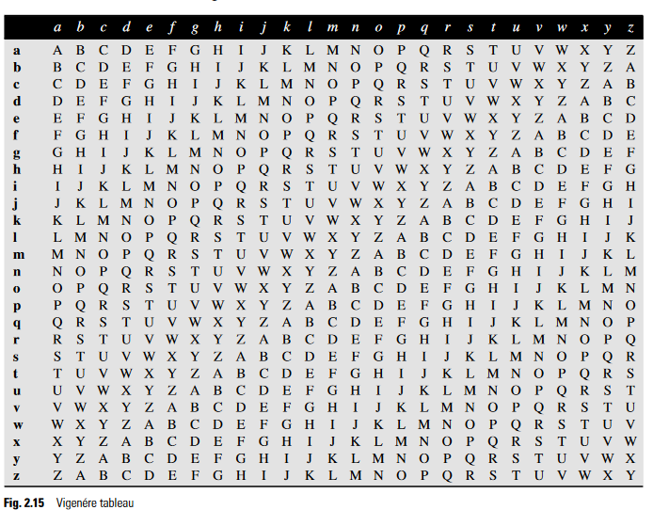
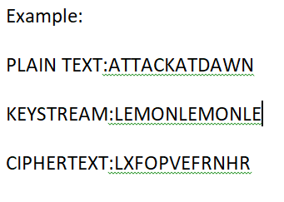

Slide 51
Playfair cipher
the Playfair cipher, also called Playfair square, is a cryptographic technique used for manual encryption of data.
the Playfair cipher was used by the British army in World War I and by the Australians in World War II. This was possible because the Playfair cipher is quite fast to use and does not demand any special equipment to be used.

Slide 52
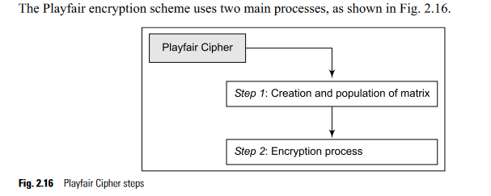

Slide 53
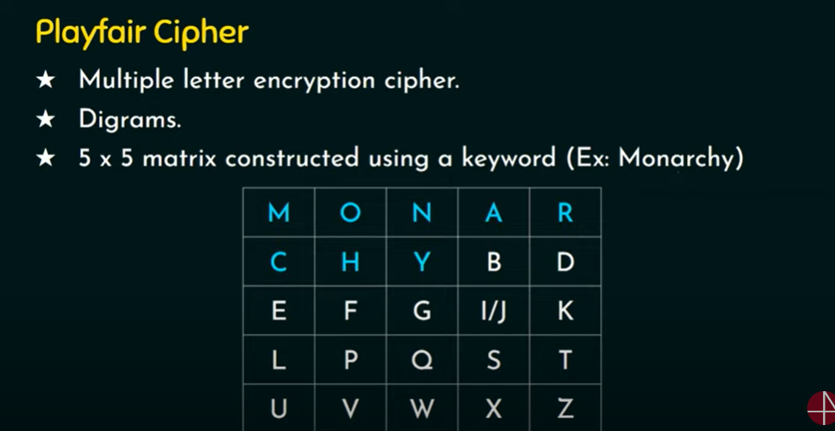

Slide 54
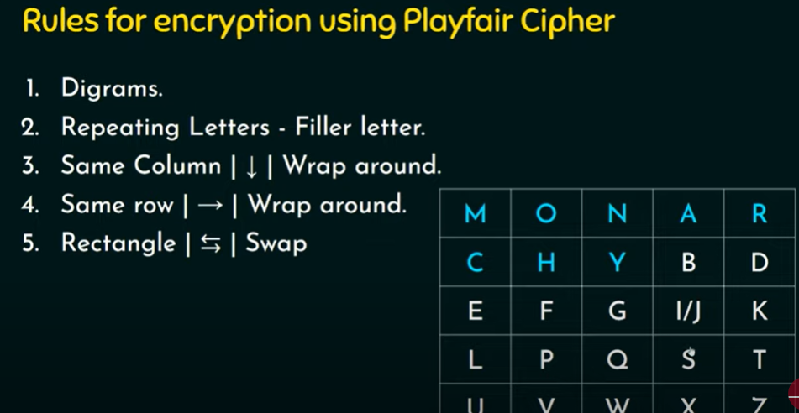

Slide 55
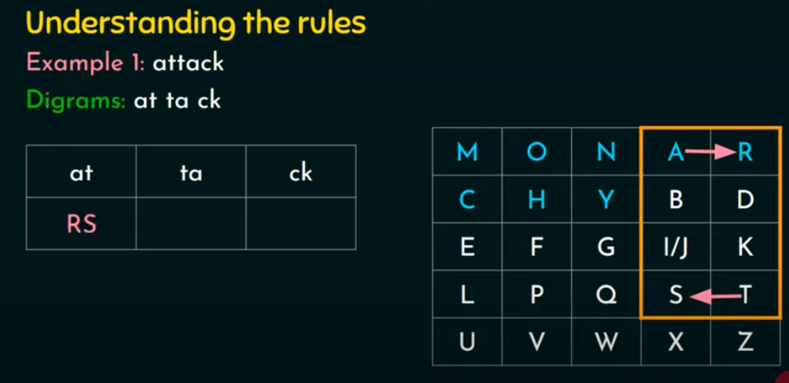

Slide 56
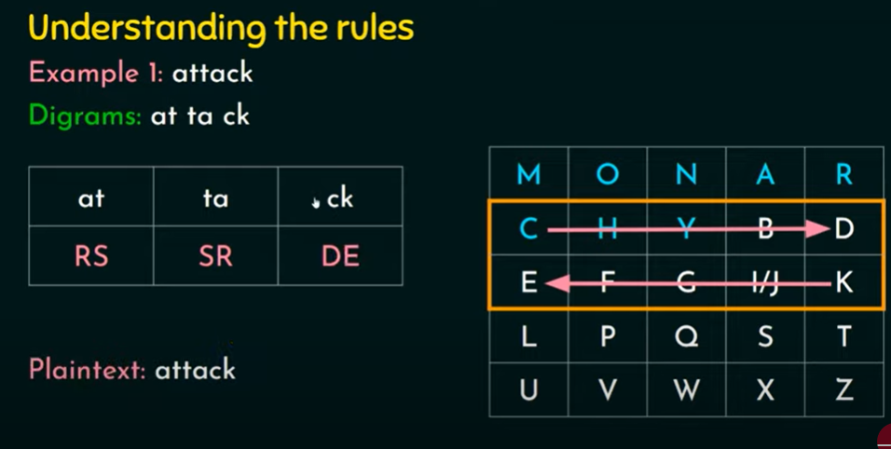

Slide 57
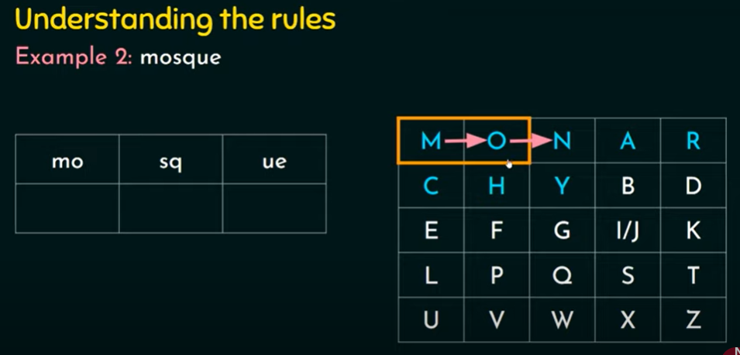

Slide 58
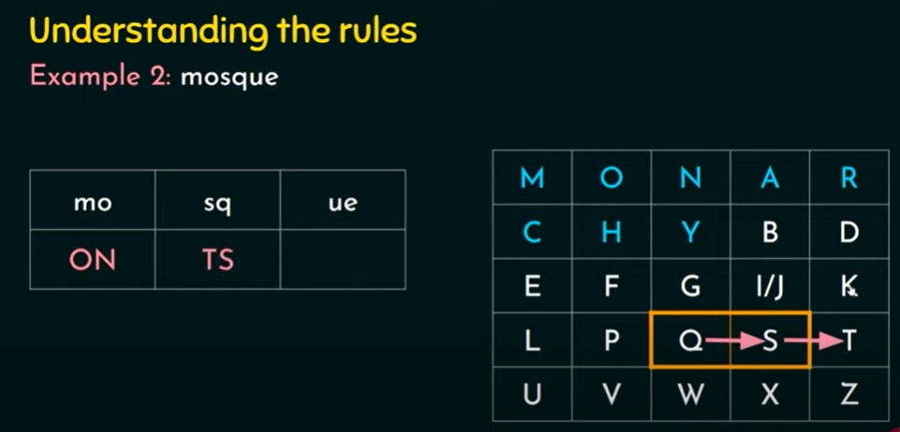

Slide 59
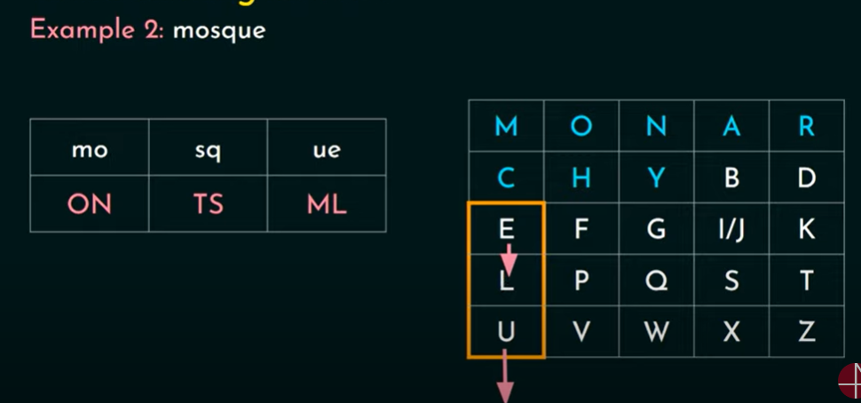

Slide 60
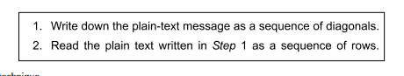
TRANSPOSITION TECHNIQUES
Transposition techniques differ from substitution techniques in the way that they do not simply replace one alphabet with another, but they also perform some permutation over the plain text.
i.Rail-Fence Technique
Rail-fence technique involves writing plain text as a sequence of diagonals and then reading it row by row to produce cipher text.

Slide 61
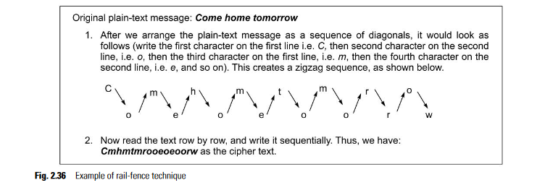

Slide 62
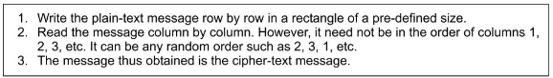
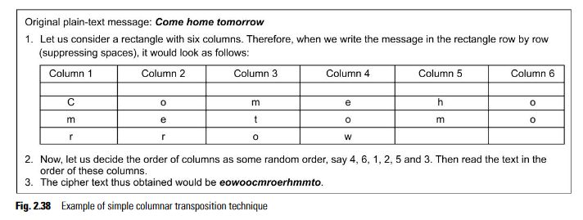
ii.Simple Columnar Transposition Technique
variations of the basic transposition technique such as rail-fence technique exist. Such a scheme is shown in Fig. 2.37, which we shall call simple columnar transposition technique.

Slide 63
the simple columnar transposition technique simply arranges the plain text as a sequence of rows of a rectangle that are read in columns randomly.
iii.Vernam Cipher (One-Time Pad)
The Vernam cipher, whose specific subset is called one-time pad, is implemented using a random set of non-repeating characters as the input cipher text. The most significant point here is that once an input cipher text for transposition is used, it is never used again for any other message (hence the name one- time). The length of the input cipher text is equal to the length of the original plain text. The algorithm used in the Vernam cipher is described in Fig. 2.41.

Slide 64
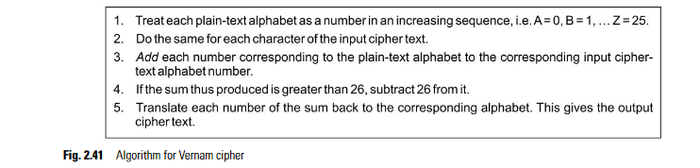

Slide 65
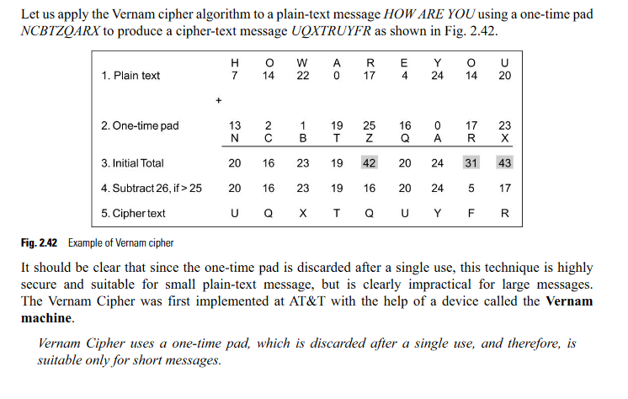

Slide 66
Steganography
Steganography is a technique that facilitates hiding of a message that is to be kept secret inside other messages. This results in the concealment of the secret message itself! Historically, the sender used methods such as invisible ink, tiny pin punctures on specific characters, minute variations between handwritten characters, pencil marks on handwritten characters, etc.

Slide 67
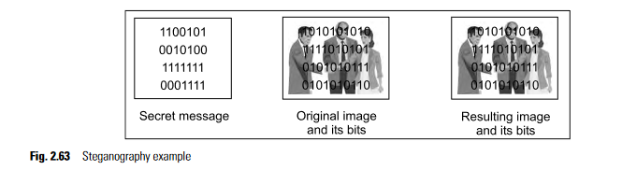
The resulting image would not look too different, and yet carry a secret message inside! The receiver would perform the opposite trick: it would read the last two bits of each byte of the image file, and reconstruct the secret message.

Slide 68
KEY RANGE AND KEY SIZE
We have already seen one way to classify attacks on information itself, or information sources (such as computers or networks). However, the encrypted messages can be attacked, too! Here, the cryptanalyst is armed with the following information:
● The encryption/decryption algorithm
● The encrypted message
● Knowledge about the key size (e.g. the value of the key is a number between 0 and 100 billion)

Slide 69
We shall consider the brute-force attack here, which works on the principle of trying every possible key in the key range, until you get the right key. It usually takes a very small amount of time to try a key. The attacker can write a computer program that tries many such keys in one second. In the best case, the attacker finds the right key in the first attempt itself, and in the worst case, it is the 100 billionth attempt.

Slide 70
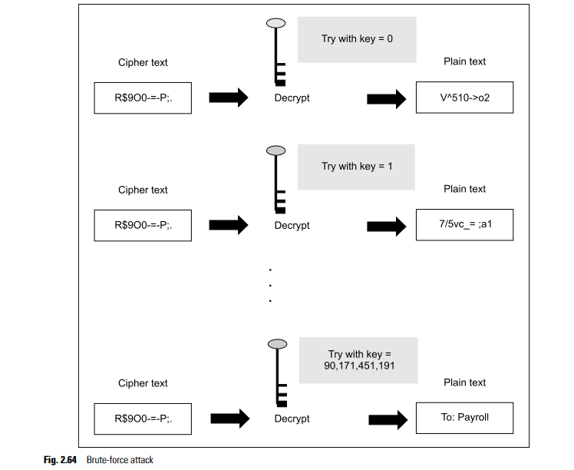

Slide 71
In computer terms, the concept of key range leads us to the principle of key size. Just as we measure the value of stocks with a given index, gold in troy ounces, money in dollars, pounds or rupees; we measure the strength of a cryptographic key with key size. We measure key size in bits, and represent it using the binary number system. Thus, our key might be of 40 bits, 56 bits, 128 bits, and so on. In order to protect ourselves against a brute-force attack, the key size should be such that the attacker cannot crack it within a specified amount of time.

Slide 72
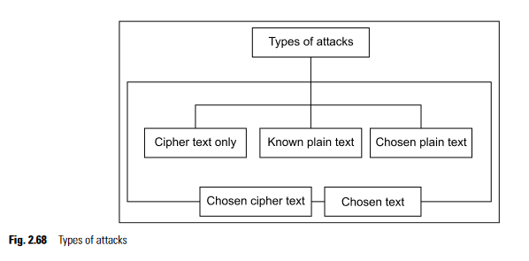
POSSIBLE TYPES OF ATTACKS
when the sender of a message encrypts a plain-text message into its corresponding cipher text, there are five possibilities for an attack on this message, as shown in fig:

Slide 73
Cipher text- only attack
The attacker analyzes the cipher text at leisure to try and figure out the original plain text. Based on the frequency of letters (e.g. the alphabets e, i, a are very common in English, etc.) the attacker makes an attempt to guess the plain text. Obviously, the more cipher text available to the attacker, more are the chances of a successful attack.

Slide 74
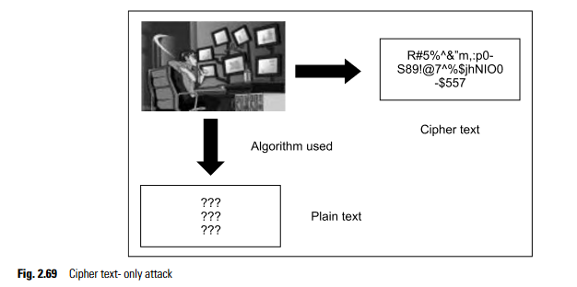

Slide 75
Known Plain-Text Attack
the attacker knows about some pairs of plain text and corresponding cipher text for those
pairs. Using this information, the attacker tries to find other pairs, and therefore, know more and more of the plain text. Examples of such known plain texts are company banners, file headers, etc

Slide 76
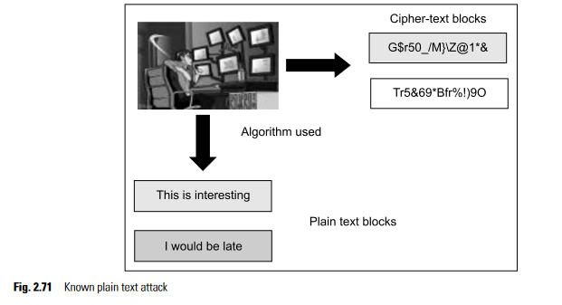

Slide 77
Chosen Plain-Text Attack
Here, the attacker selects a plain-text block, and tries to look for the encryption of the same in the cipher text. Here, the attacker is able to choose the messages to encrypt. Based on this, the attacker intention- ally picks patterns of cipher text that result in obtaining more information about the key.

Slide 78
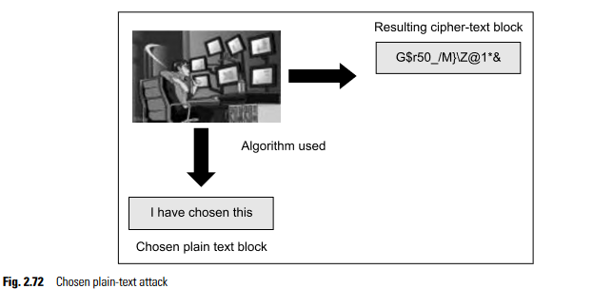

Slide 79
Chosen Cipher-Text Attack
In the chosen cipher-text attack, the attacker knows the cipher text to be decrypted, the encryption algorithm that was used to produce this cipher text, and the corresponding plain-text block.
The attacker’s job is to discover the key used for encryption. However, this type of attack is not very commonly used.
Chosen-Text Attack
The chosen-text attack is essentially a combination of chosen plain-text attack and chosen cipher-text attack. This is shown in

Slide 80
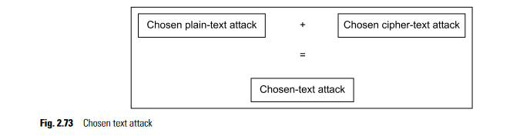

Slide 81
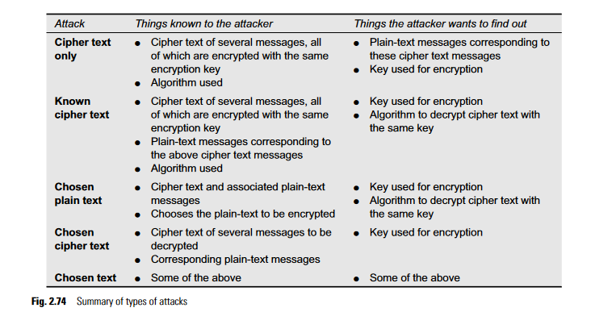
summarizes the characteristics of these attacks

